Slide 1
STUDENT SYSTEM
DISCOVER THE VALUE!!!
Session 4
Presented by Linda Putu

Slide 2

TABLE OF CONTENTS
Student Team
The Importance of Best Practice
Product Enhancements

Slide 3
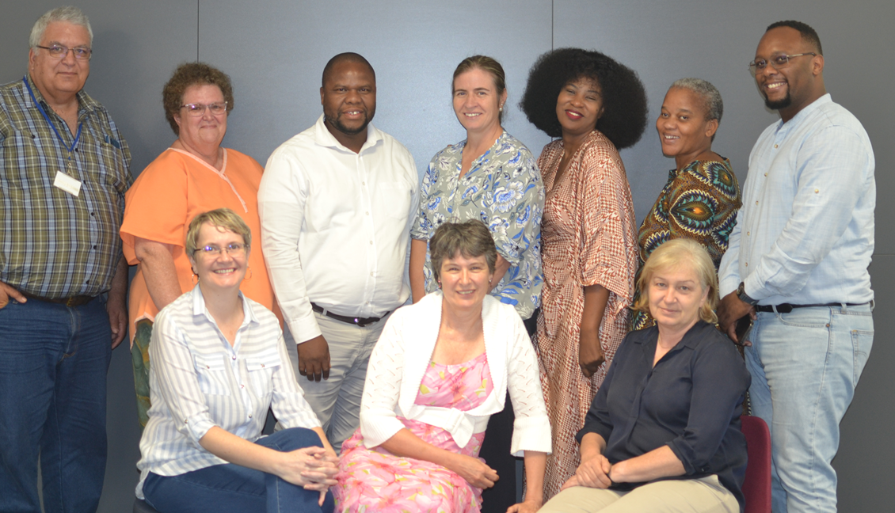
STUDENT TEAM
Team Values Define Culture
Wholehearted Support
Cultivating a Supportive Environment

Slide 4

THE IMPORTANCE OF BEST PRACTICE

Slide 5
BEST PRACTICE FOR MATRIC RESULTS
Access Verification:
Access Restriction Setup:
  Validate access to all Matric Result menu options and data-derived menus.
  Restrict access for all back-office menus to authorized users during embargoed periods.
Authorization Protocols:
Cycle and iEnabler Preparation:
  Submit authorized personnel lists to USAF for seamless access management.
  Set up cycles, iEnabler options, and review LS menu options for the embargoed period.
Yearly Parameter Finalization:
Handling 'Invalid' Data:
  Ensure parameter list is finalized by December each year for effective system control.
  Define protocols for handling 'invalid' data received from the DBE.
Embargoed Period Functionality:
Emergency Support Contacts:
  Establish a dedicated function for exclusive use during embargoed periods.
  Link this function to back-office menus, facilitating dynamic user management.
  Identify contacts for night support and confirmation during Adapt's critical needs.

Slide 6
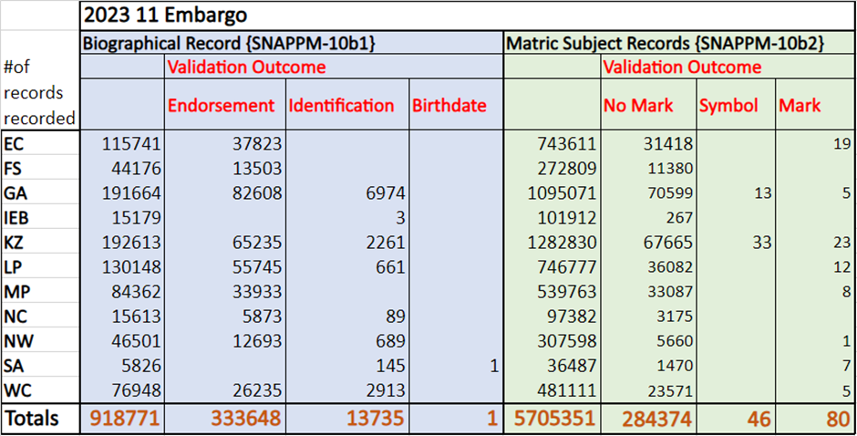
EMBARGO RESULTS

Slide 7
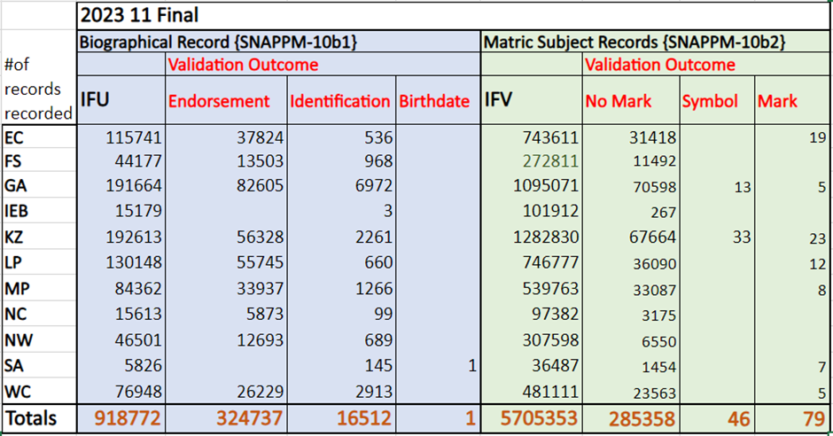
FINAL RESULTS

Slide 8
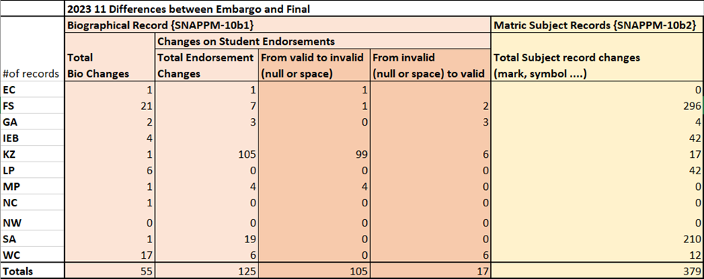
Final Results

Slide 9
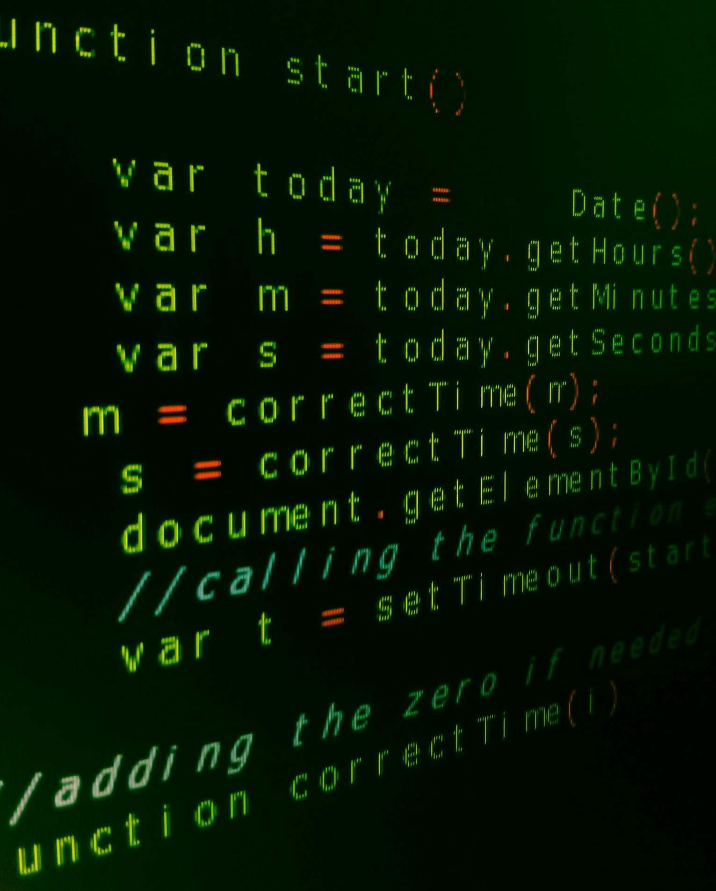
New C Program
NEW C PROGRAM
1. Recalculation Criteria (Step 1):
5. NSC PASS = 'N' (Step 5):
  Recalculation is triggered if the student has multiple sittings or possesses a null endorsement with a 2024 application record.
  If NSC PASS is 'N', the student is ignored, and "NSC NOT Passed" is printed.
2. Endorsement Criteria (Step 2):
6. NSC PASS = 'Y' + >= 50% in four 20 credit subjects (Step 6):
  No re-calculation is performed if the endorsement is 'B'.
  Exclusion if Endorsement is NC on SREGB-1; this is crucial for cases where students may have SNAPPM-10 despite applying with an NC matric type.
  If NSC PASS is 'Y' and the student achieves at least 50% in four 20 credit subjects, it qualifies for a 'B' Degree Endorsement.
7. NSC PASS = 'Y' + >= 40% in four 20 credit subjects (Step 7):
3. Subject Count Criteria (Step 3):
  If NSC PASS is 'Y' and the student achieves at least 40% in four 20 credit subjects, it qualifies for a 'D' Diploma Endorsement.
  The student must have at least 7 distinct subjects in one or multiple sittings.
  Identify the best 6 different subjects (excluding LIFE) if the student has more than 7 subjects.
8. NSC PASS = 'Y' + >= 30% in Language of Teaching and Learning (English) (Step 8):
4. NSC Pass Calculation (Step 4):
  If NSC PASS is 'Y' and the student achieves at least 30% in the Language of Teaching and Learning (English), it qualifies for a 'C' Certificate Endorsement.
  A new rule for NSC Pass is calculated and inserted into the 'NSCPASS' field.
9. NSC PASS = 'Y' + Criteria not covered in Steps 9 to 11 (Step 9):
  If NSC PASS is 'Y' and the student does not meet the criteria in Steps 9 to 11, it results in an 'N' No Endorsement.

Slide 10
JANUARY ACTIVITIES STUDENT TEAM CHECKLIST
Student Team Checklist
Database Metrics:
  Assess the size of GOGWWD and GJPWSI databases.
Batch Management:
  Confirm that BATCH-9 is operational to maintain GOGWWD and GJPWSI tables.
iEnabler Maintenance:
  Verify and update the expiry time on iEnabler for seamless functionality.
Session Optimization:
  Review and adjust session limits on the Wizard platform.
Additional System Checks by Gencore/Dba
Mailserver Health:
  Ensure the mailserver is functioning optimally to facilitate routing.
Job Processes:
  Monitor and clear any 'broken' or 'failed' jobs in user_jobs for streamlined processes.
Database Performance:
  Evaluate the result_cache on the database for optimal performance.
Ensuring Smooth Operations for January Activities

Slide 11

PRODUCT ENHANCEMENTS

Slide 12

PRODUCT OPTIMIZATION
REQUIREMENTS
These would come from our external and internal stakeholders
DISCOVERY &ASSESSMENT
The team would sit down and discuss the requirements and assess them.
FEASIBILITY STUDY
We would do an impact analysis and check if it is not breaking the system.
MARKET ANALYSIS
The business development team will evaluate potential interest from other clients.
DEVELOP
It will go into the product backlog
PRODUCTS
The product will be available for the market

Slide 13
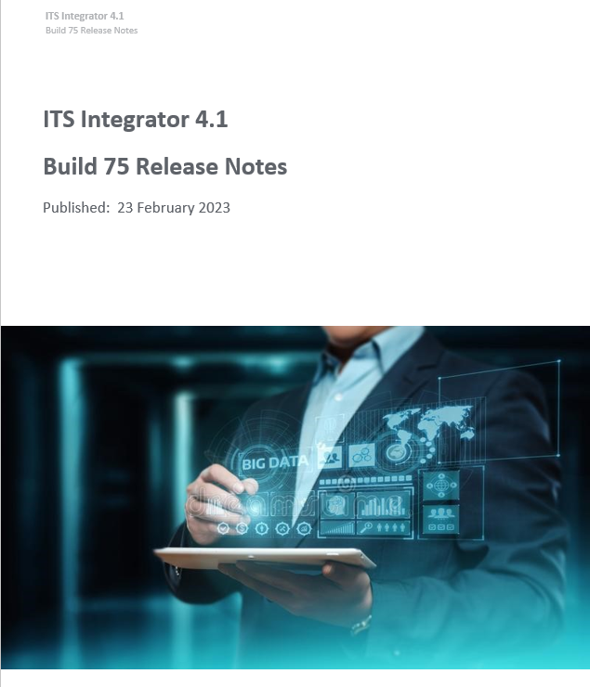
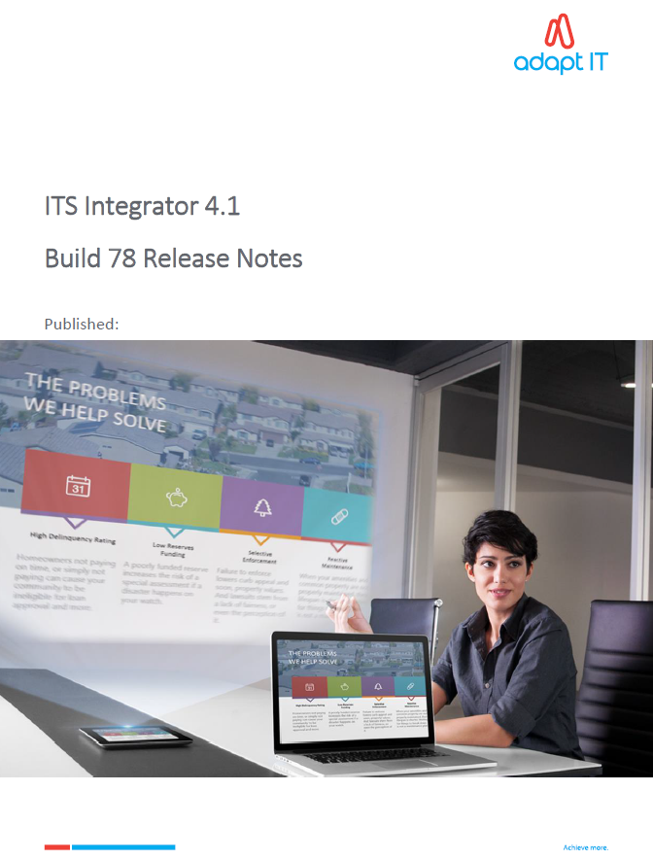

BUILD AND RELEASE NOTES

Slide 14
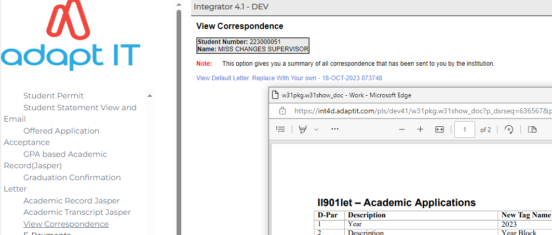
IENABLER ICOMMS CORRESPONDENCE

Slide 15
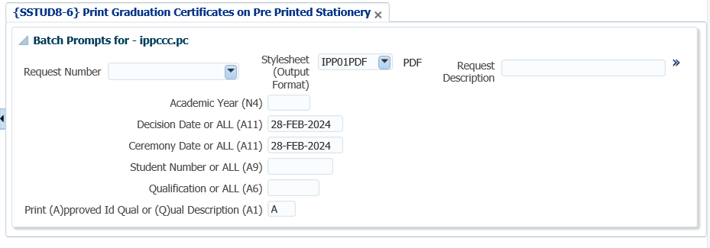
PRINTING OF GRADUATION CERTIFICATION CORRESPONDENCE

Slide 16
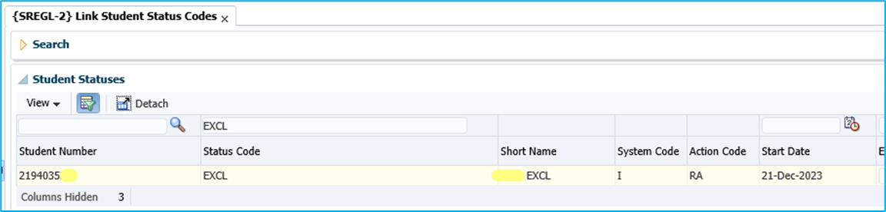
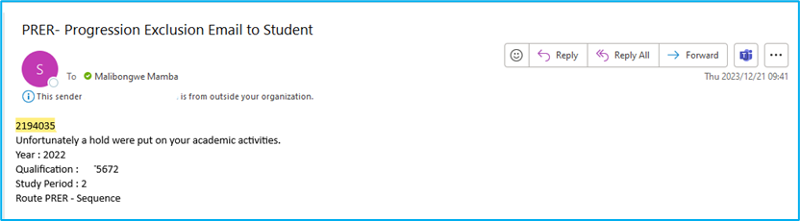
STUDENT EXCLUSION

Slide 17
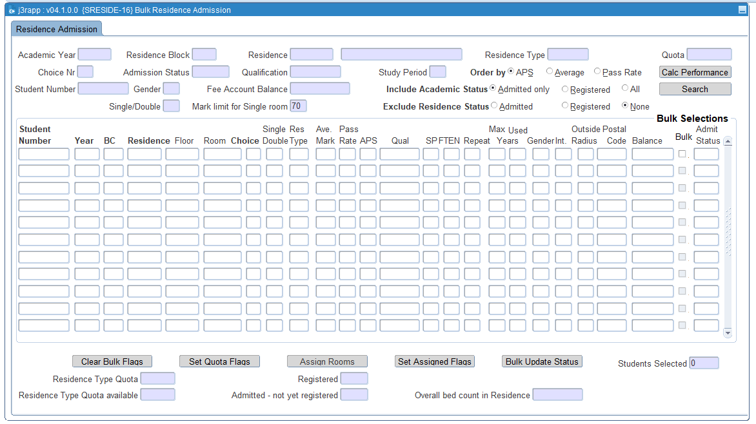
BULK RESIDENCE ADMISSION ENGINE

Slide 18
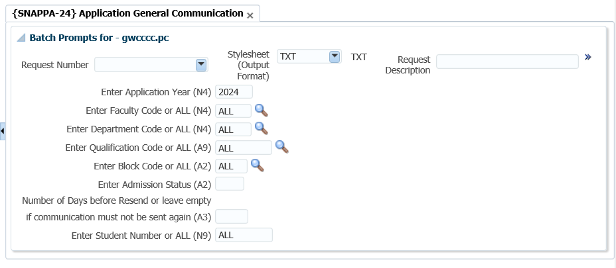
COMMUNICATION PROGRAM ON ADMISSION STATUSES

Slide 19
NSFAS TRANSPORT FIELD ON APPLICATION

Slide 20
NSFAS TRANSPORT FIELD ON APPLICATION

Slide 21
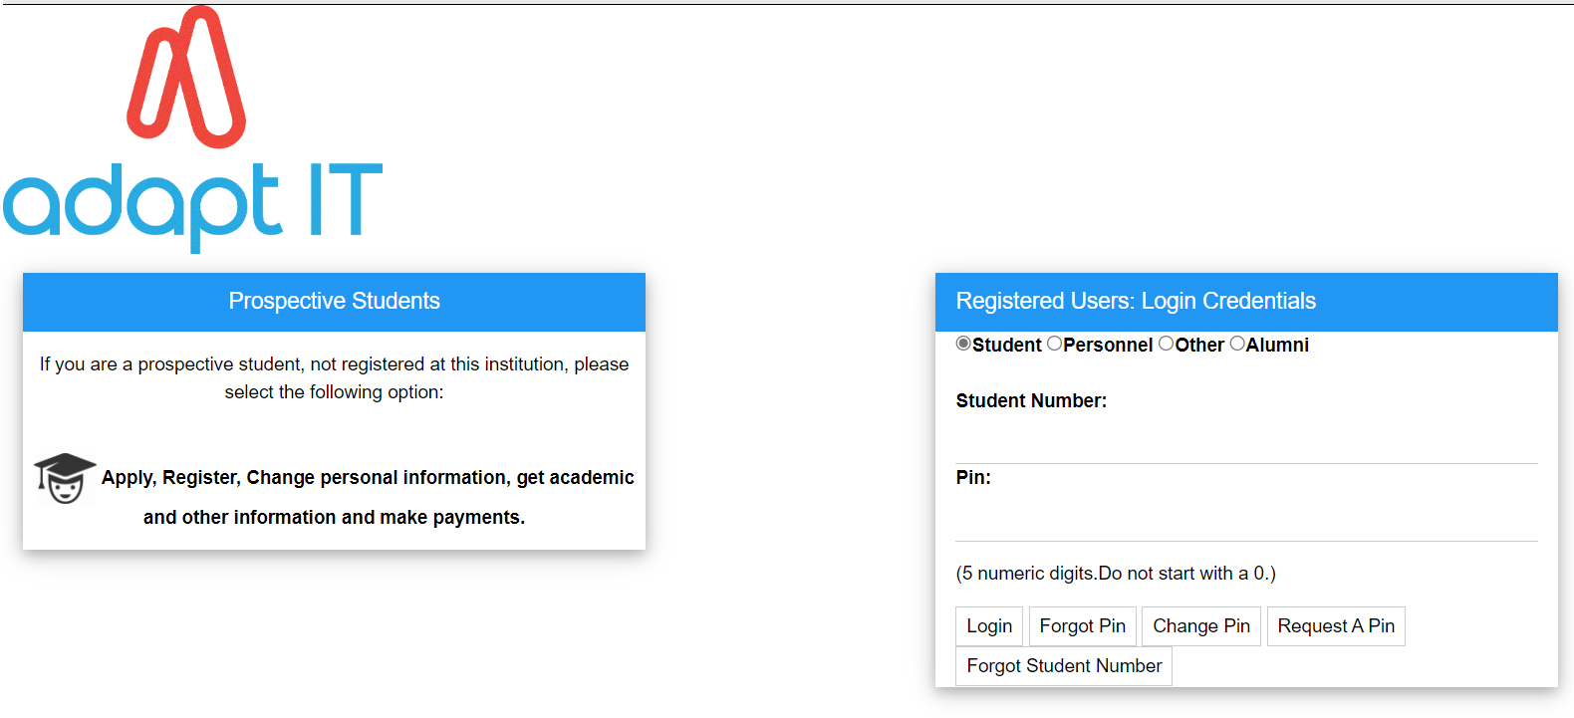
IENABLER ACCESS FOR CANCELLED STUDENT

Slide 22

QUESTIONS?

